Slide 1
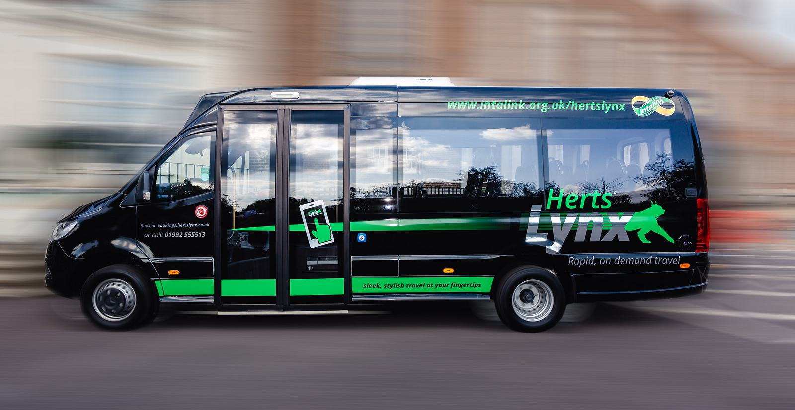
Bus Service Improvement Plan
For Hertfordshire

Slide 2
What is a BSIP?
The National bus strategy (published 2021) set out an ambitious vision to dramatically improve bus services in England. This in order to reverse the recent shift away from public transport and encourage passengers back to the bus.
Bus Service Improvement Plans (BSIPs) are how Local Transport Authorities, working closely with local bus operators, and local communities will set out the vision, delivering a step-change in bus services
HCC submitted a BSIP and have received 29.7m in funding over three years. Fewer than half of authorities received funding

Slide 3
Key Ambitions
Incentive | Ranking
Increased frequency of services | 1
Increase Real time information at bus stops | 2
Bus priority measures such as bus lanes to quicken journey times | 3
Buses running later in the evenings | 4
Increase the range of multi-operator and smart tickets | 5
Flexible ticketing options | 6
Upgrade the Intalink mobile ticketing app | 7
Demand Responsive Transport options | 8
Wi-Fi available at bus stops | 9
USB charging at bus stops | 10

Slide 4
Areas of focus
Bus Service Corridors
Bus Priority
Fares and Ticketing
Demand Responsive Transport
Bus Shelter information and improvement
Enhanced marketing

Slide 5
Introduce New Links
Augment key corridors with new services providing additional links and provide new links on the secondary network where this demonstrated value for money
Enhance Evening / Weekend Travel
Focus improvements on a core midweek period of 0700-1900 but look to extend the benefits later into the evening and across the whole week with new services and frequency uplifts
Expand DRT Services
Build on the success of HertsLynx by reviewing the value of some fixed links on the secondary network and replacing with DRT where greater flexibility can conect at key points to the core network
Improve frequencies on existing corridors
Focus on five main towns:
Hertford,
Stevenage,
St Albans,
Watford,
Hemel Hempstead

Slide 6
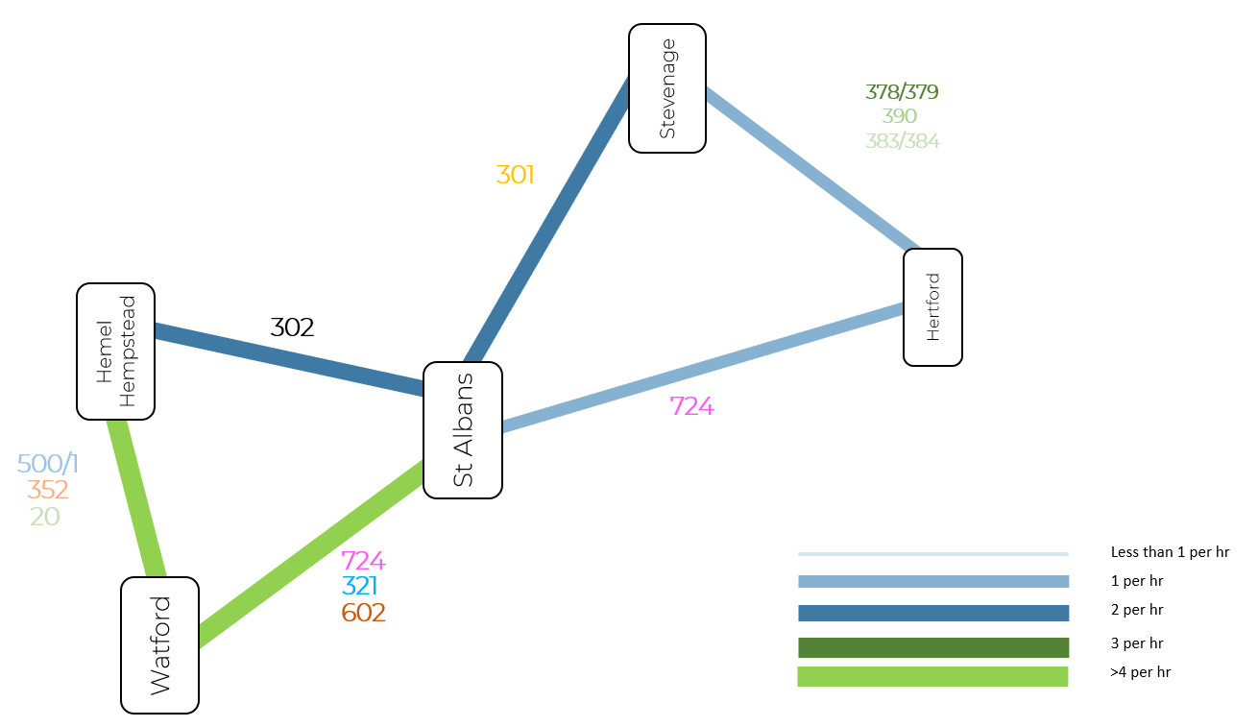

Slide 7
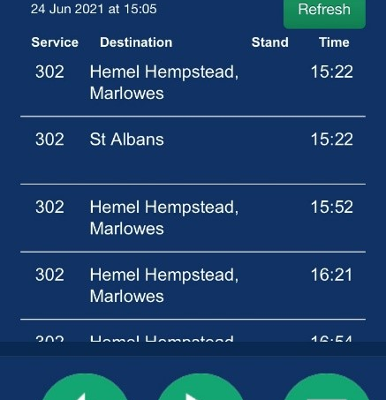
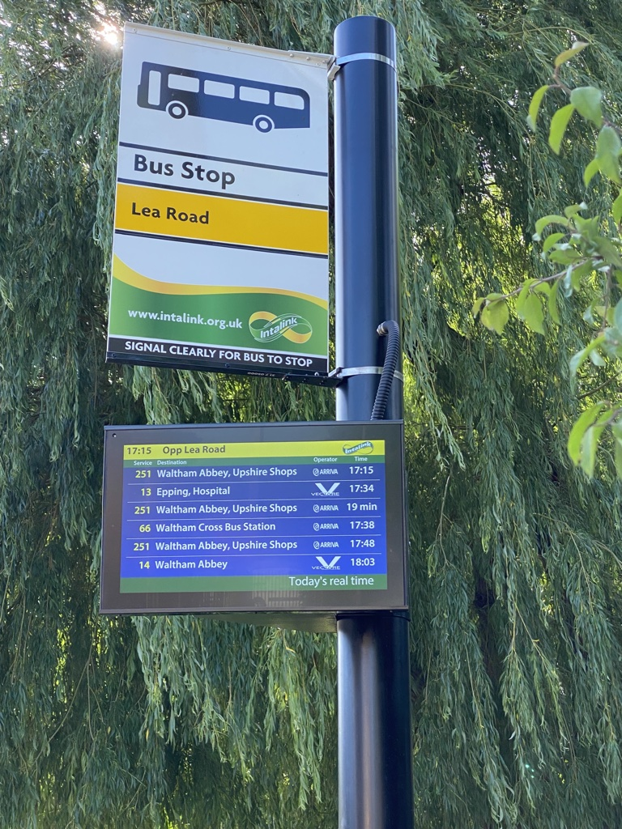
A better passenger experience

Slide 8
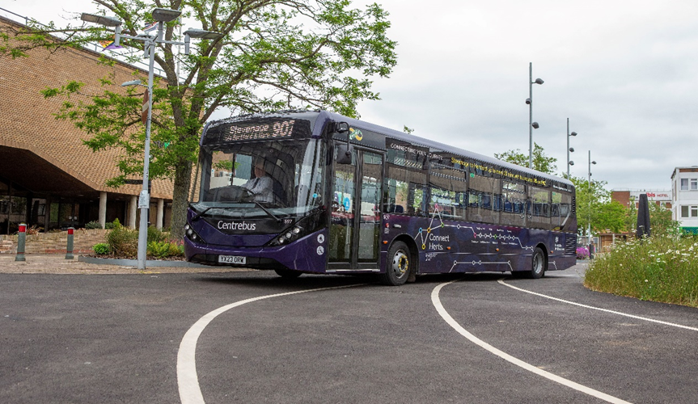
A better passenger experience

Slide 9
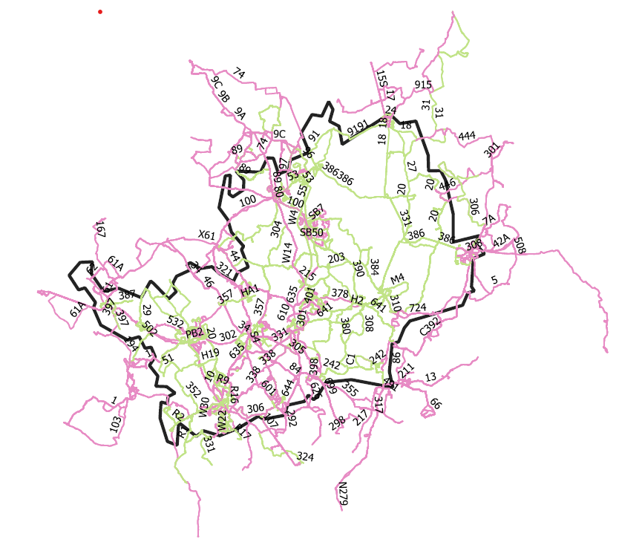
Rural Transport focus

Slide 10
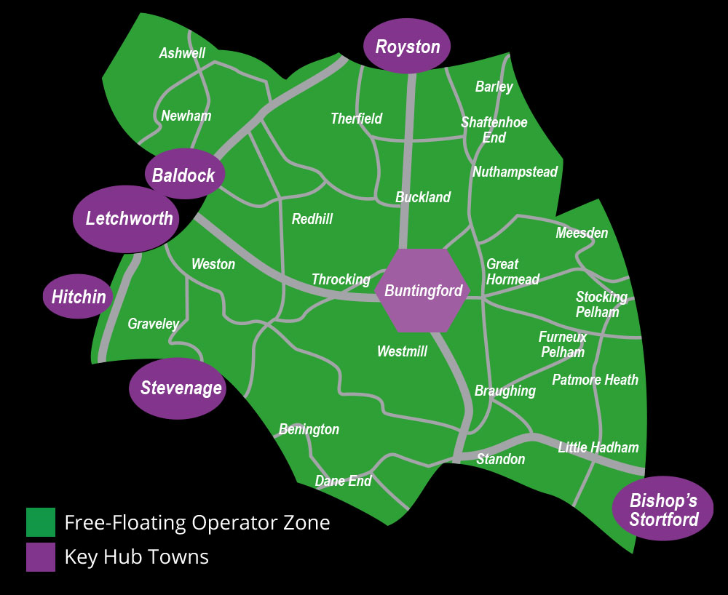
Demand Responsive Transport in Hertfordshire
Awarded £1.4 million from DfT’s Rural Mobility Fund
DRT “Zone” with additional key hubs in 6 surrounding towns
Operational Mon – Saturday 07:00 – 19:00 Sundays & Bank Holidays 10:00 – 16:00
New expanded hours Friday and Saturday evenings until 2330

Slide 11
Future plans and expansion
Expand existing service to Operate every Friday & Saturday from 20:00 – 23:30 (commenced mid April 2023)
Expand current zone to serve more towns and rural areas (Autumn 2023)
Introduce a new HertsLynx service to the west of the county (Autumn 2023)
Pilot Community Transport providers utilising technology to operate HertsLynx style services
Pilot a more integrated Dial A Ride service with HertsLynx

Slide 12
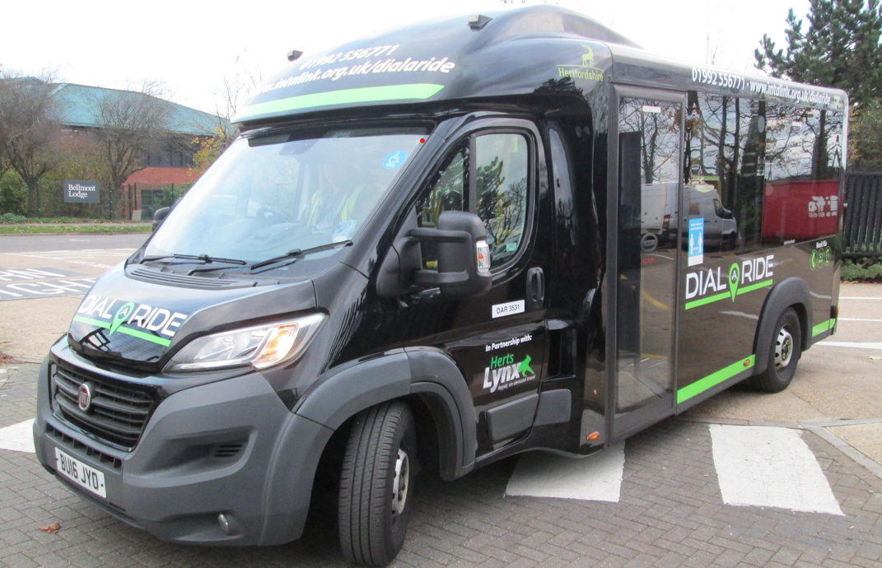
Dial a Ride x HertsLynx
Integration in the back end and front end to provide sustainable services
Dial a Ride vehicles (12 across the county) rebranded and now have booking technology
First integration pilot in Autumn 2023

Slide 13
Conclusion
Bus Service Improvement Plan in progress and ambitious
HertsLynx embedded as a brand and service – how does it evolve
Integrated transport model – how do we further remove silos
How do we remove the bus vs demand responsive binary choice

