Slide 1
Addressing Rural Transport
14th November 2022

Slide 2
Rural Agenda: Llwbyr Newydd
1
2
3
Transport
Transport related
Digital
Connectivity
Integration
Frequency
Active travel
Road safety
Local journeys
E bikes
Car share
Car clubs
Bus and taxi services
New transport technologies
Superfast work hubs
Home working

Slide 3
Rural Agenda: Three Phases
1
2
3
Defining the scope – What is rural?
How well connected is rural Wales?
Principles to be agreed and options to explore.
Delivery Plan
Defining urban/rural areas of Wales relevant to the scope of the study.
Identifying individual settlements within the rural areas.
Compiling/analysing the existing public transport provision data for each of the rural settlements.
Local authority pilot area case studies leading to development of an all-Wales methodology.
Range of factors and options to explore.
All-Wales prioritisation method for options.

Slide 4
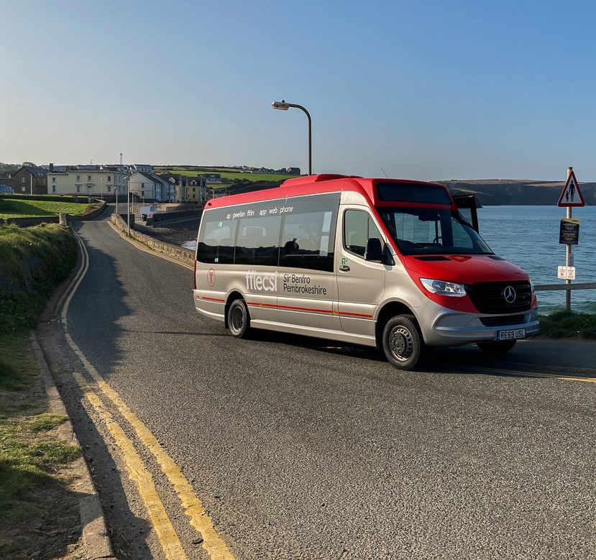
1
Defining the scope – What is rural?
Fflecsi in Pembrokeshire - https://news.tfw.wales/resources/kqdx5-4cs8v-3mf0j-9jnxc-gi3sl

Slide 5
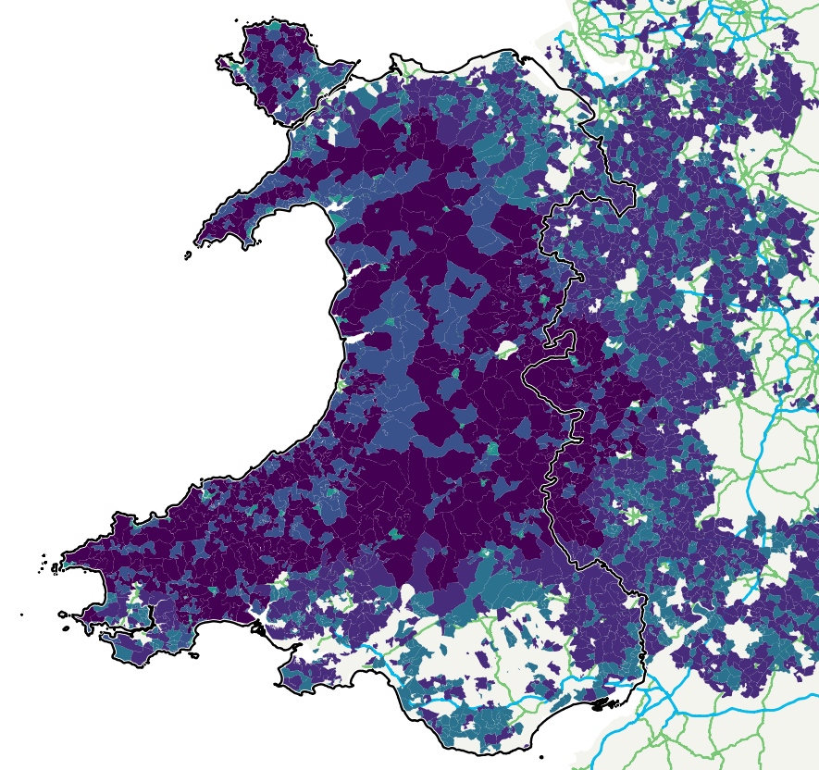
Identifying what is rural
Rural Urban Classification 2011 (ONS)
Accepted industry standard method of distinguishing rural and urban areas across England and Wales.
Following a review of the RUC11 classification categories, it was decided to exclude the ‘D1: Rural towns and fringe’ category. This helps to refine areas in-scope more appropriately.
The 5 most rural RUC11 categories are now included as being within scope.
Output areas within Wales that are also within these categories have been used for the analysis.

Slide 6
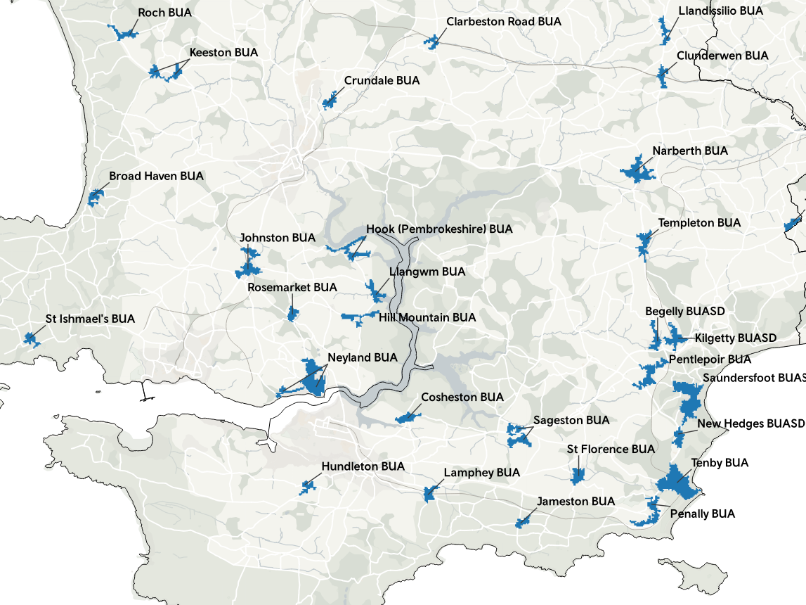
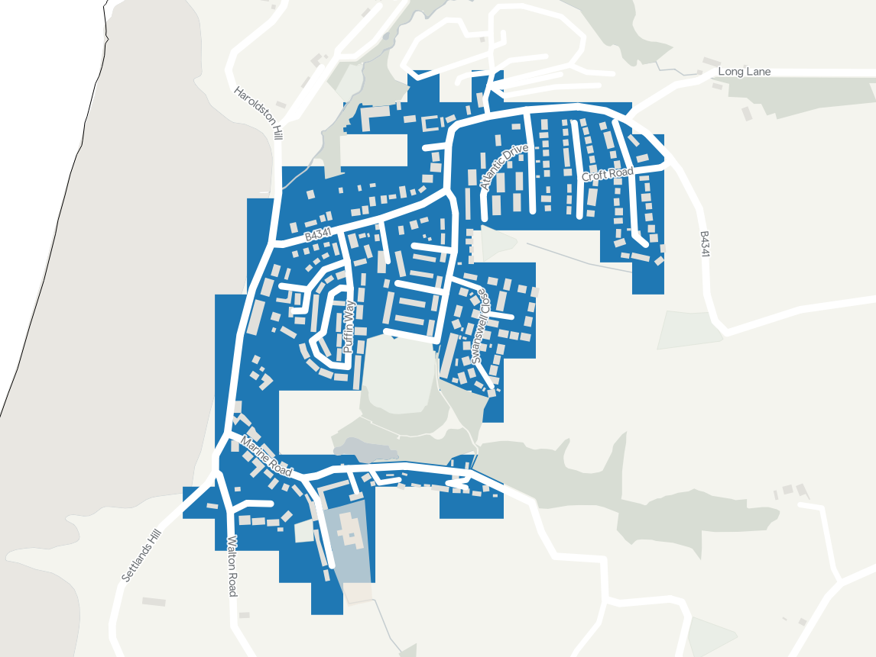
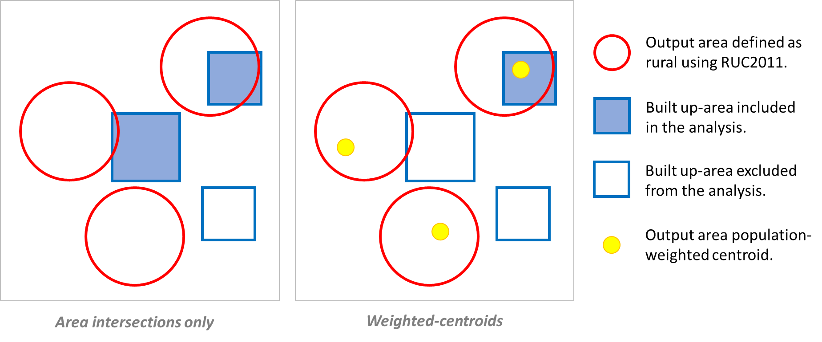
Identifying individual settlements in rural
Built-up areas are defined by Office of National Statistics (ONS) as land which is ‘irreversibly urban in character’, meaning that they are characteristic of a village, town or city. They include areas of built-up land with a minimum of 20 hectares (200,000m2). Only areas with less than 200 metres between them are linked to become a single built-up area.
Using ONS built-up areas allows us to analyse the individual settlements rather than large zones which contain multiple settlements, and also gives us access to ONS population estimates.
Where RUC11 categories spatially joined with built-up areas we used population weighted centres to improve the accuracy of which built-up areas should be included in the analysis.
< Broad Haven BUA

Slide 7
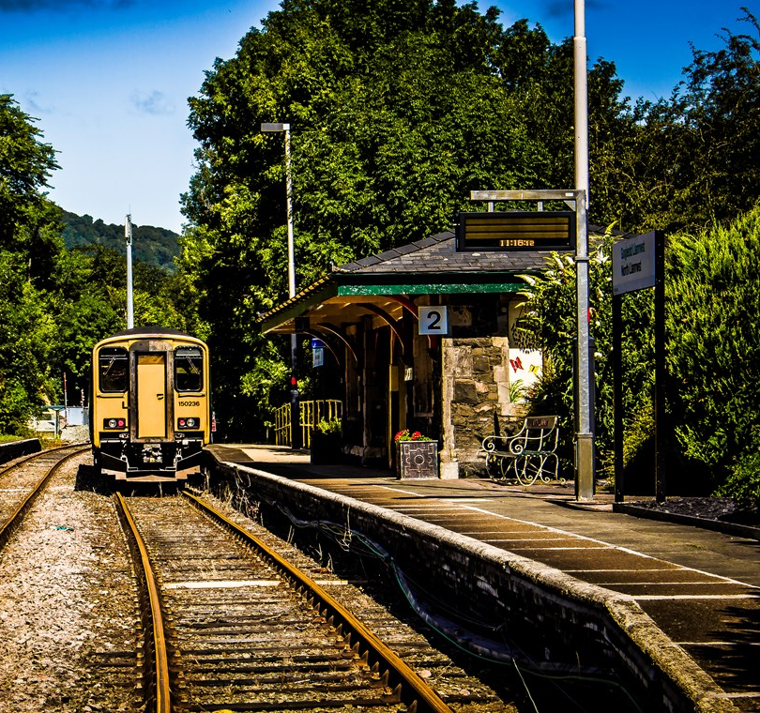
2
How well connected is rural Wales?
North Llanrwst station (Credit: Robert Mann) - https://news.tfw.wales/resources/yb0u4-xti2t-zkr9g-nigma-t3i31

Slide 8
Consistent hourly PT service (≥ 1 per hour)
All rural built-up areas (incl. sub-divisions) in Wales:
Using TRACC software, all PT stops and stations with a consistent frequency of at least 1 per hour between 7am-7pm on a weekday, Saturday and Sunday were identified and plotted.
This was then overlaid with the Built-up areas incl. sub-divisions (BUASDs) to identify which built-up areas contained PT stops/stations with services of at least 1 per hour in frequency.
The summary statistics are categorised in groups based on the population estimates for rural built-up areas. Examples are given here for all rural BUASDs in Wales and an excerpt of rural BUASDs with a population between 300 and 499.
→
Rural built-up areas (incl. sub-divisions) in Wales with population between 300 and 499:
→
→

Slide 9
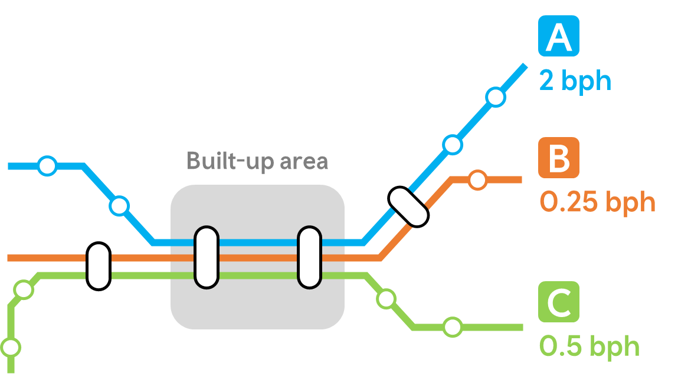
Bus frequency (incl. < 1 per hour)
Using Basemap bus route line data, the bus route lines were clipped to only include those which pass through a built-up area during a range of time periods on weekdays, Saturdays and Sundays.
The analysis is conducted in two ways. For max frequency, the service with the highest frequency is assigned to each built-up area, whereas for total frequency, the combined total of all services is assigned to each built-up area.
The summary statistics are categorised in groups based on the population estimates for rural built-up areas. Examples are given here for max bus frequency in rural BUASDs in Wales with a population between 300 and 499, and also an example of the difference between max and total frequency figures.
Max hourly frequency available:
2 bph
Total hourly frequency:
2.75 bph
AM peak: 07:00 – 08:59
IP (inter-peak): 09:00 – 15:59
PM peak: 16:00 – 17:59

Slide 10
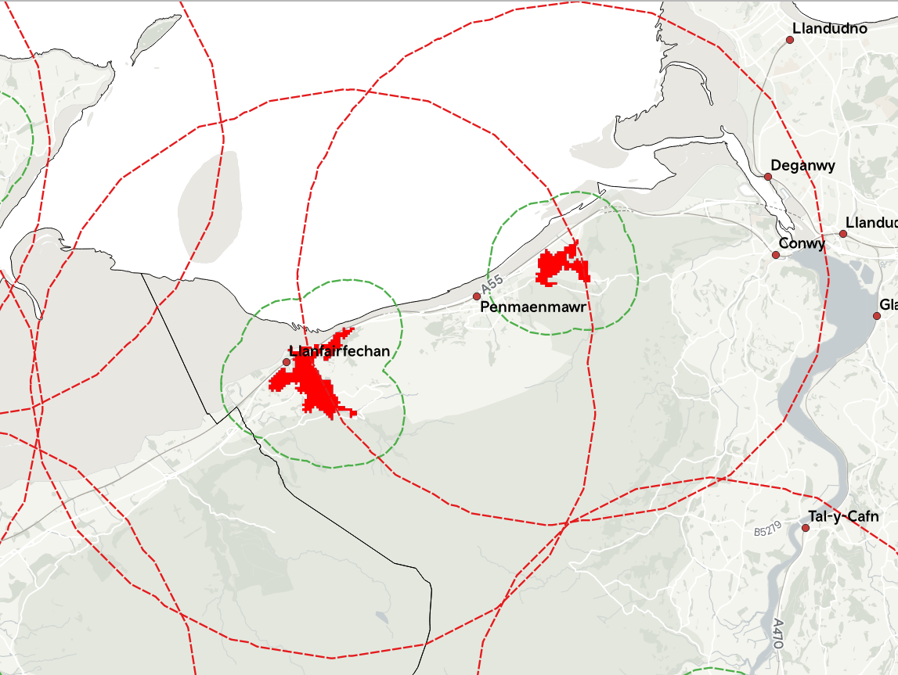
Daily rail frequency
Using TfW’s ‘Train Service Requirements’ (TSR) data, we can identify the ‘current’ level of service at each station, presented as a daily no. of trains.
The dataset gives annual estimates up to 2024, based on the franchise commitments and expected service frequency changes.*
The data is split into regions/routes, arrivals/departures and also into weekday, Saturday and Sunday periods.
In GIS, we can identify which built-up areas contain a rail station served by TfW Rail services, and which have a station within a specified distance (currently set at 1km and 5km).
These identified stations can then be cross-referenced back to the TSR data.
* Estimates of future frequency subject to change.

Slide 11
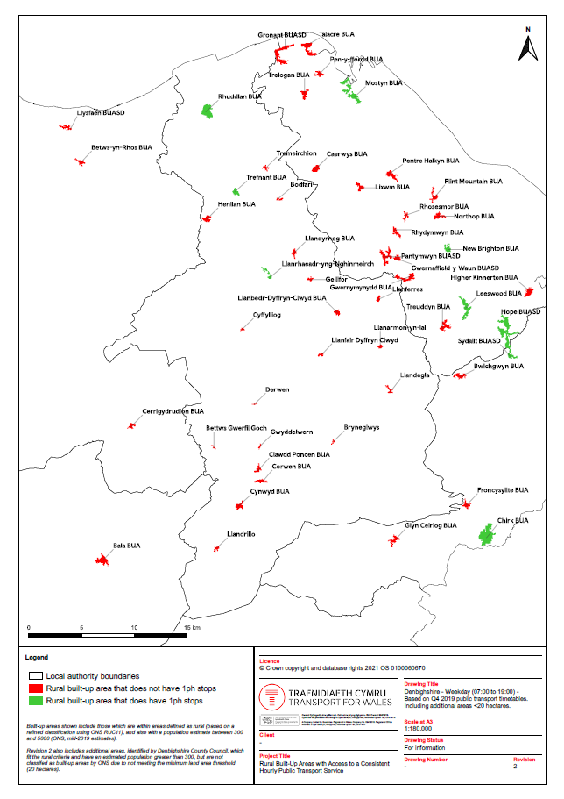
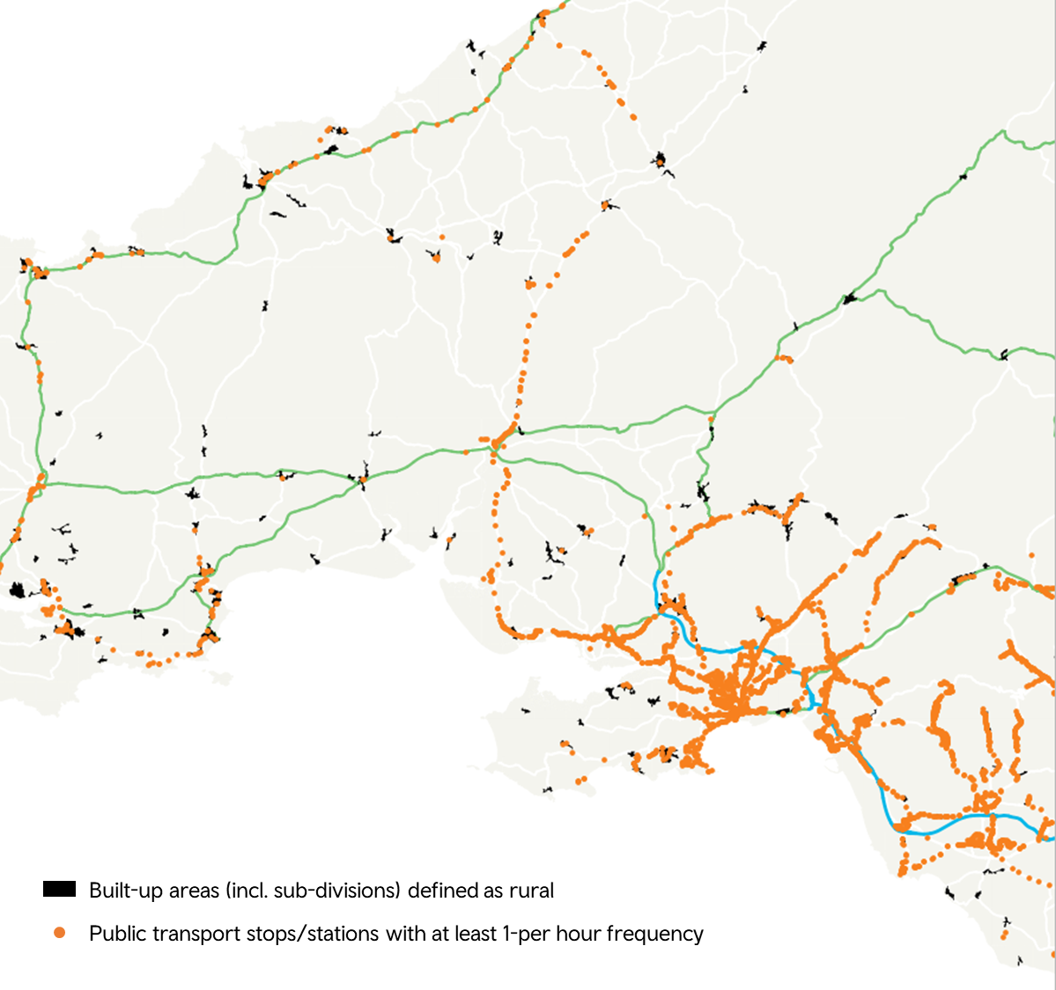
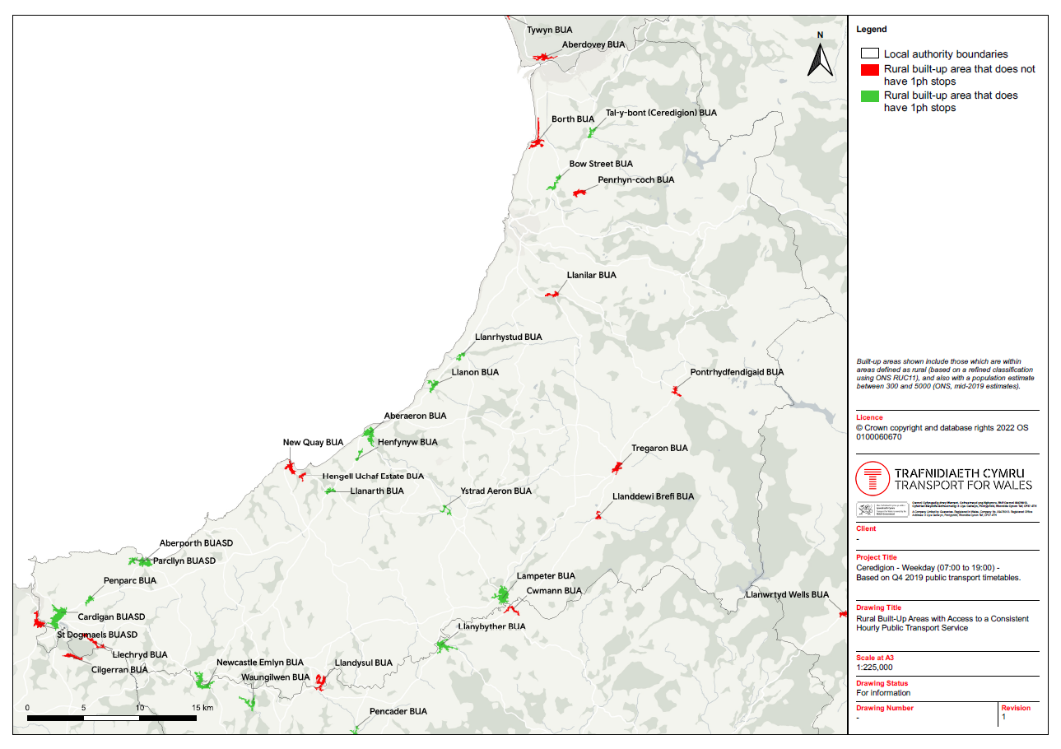
Outputs
GIS map examples:
Summary table – Gives more detail on specific built-up areas for the datasets discussed. Also allows to identify individual scheduled bus services which serve each area.
Rural Urban Classification Note – Provides more detail about the decision made to begin with RUC11 and then refine it’s categorisation for this specific work.
GIS maps – Allows for viewing of the statistical data spatially, so that geographic trends can be identified. Also allows for scales to be customised and other datasets to be overlaid and compared.

Slide 12
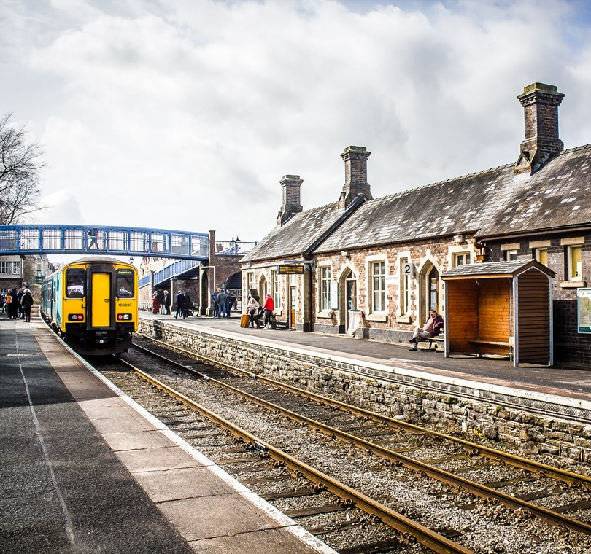
3
Principles to be agreed and options to explore
Llandrindod Wells station - https://news.tfw.wales/resources/4s6td-qtfsb-m5hgq-aeylt-we9z9

Slide 13
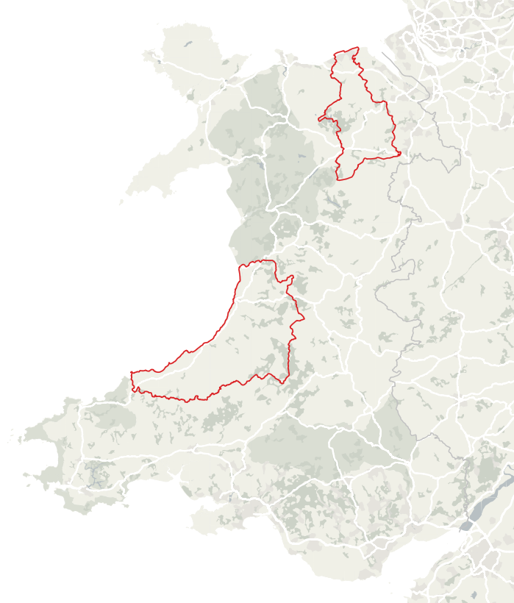
Example case studies:
Bus frequency cost estimates
Two pilot areas chosen to explore options to boost services to required standard: Ceredigion and Denbighshire.
For each, a high level service design was developed for hourly services and associated estimated costs.

Slide 14
Ceredigion excerpt:
Cost estimates:
Place | Pop. | Current Bus Service | Action Required
Aberporth | 1241 | T5 – 12 trips M – F; 7 trips Sat. 552 – 1 trip Th; 2 trips F&S 554 – 5 trips M – F; 3 trips Sat. | Increase T5 to hourly M-S and introduce Sunday service.
Borth | 1399 | 512 – 11 trips (hourly 08:00 – 18:00) | Add 1 extra trip am and pm M-S and introduce Sunday service.
Felinfach | 346 | T1 – 10 trips M – S (until 19:00) | Increase T1 to hourly M-S and increase Sunday service.
Hengell Uchaf |  | 5 minutes walk from T5 in New Quay 11 trips to Aberystwyth 06:30 – 18:30 M – S 9 trips to Haverfordwest 09:00 – 20:30 M-S | Increase T5 to hourly M-S and introduce Sunday service.
Ceredigion:
Monday – Saturday: £1.09M
Sunday: £0.6M
Denbighshire:
Monday – Saturday: £0.31M
Sunday: £58K
Not confirmed with bus companies – or considered impact of COVID on "baseline" service viability
Costs based on £130K p.a. for an all-day/week bus (excluding Sunday); £40 an hour for a part day/week bus; £25K p.a. for a Sunday all day bus

Slide 15
Potential issues:
Affordability – COVID impact on patronage will increase “as is” subsidised service costs, before additional costs shown here.
Journey times – Buses will be routed circuitously to cover all villages, which will increase journey times for many.
Demand – Should grow with a better service, but is not proven for an hourly service and buses may often be empty, especially initially.
Coverage – people in smaller settlements (e.g. population <300) and more isolated settlements may not benefit from the additional services.

Slide 16
Factors to consider going forward:
Policy
Do local or national policies align with the existing transport provision, and to what extent can they be used to plan/prioritise schemes to improve the provision?
WIMD/Levels of Deprivation
By combining WIMD data with the frequency-based analysis, are there any identifiable trends regarding how areas currently have access to public transport based on their level of deprivation?
1
5
Demand
Using datasets such as the regional transport models or mobile phone data to identify key movement patterns, opportunities be found for more targeted interventions?
Active Travel
To what extent can safe active travel routes be provided to nearby centres and towns to encourage modal shift in rural communities?
2
6
Economic/Finance & Social
What budget is available for transport interventions in rural areas? How can the various economic and social impacts of accessibility to public transport be valued?
Option Prioritisation
How can potential interventions be scored or prioritised to ensure the greatest benefits are found? Do rural-specific considerations need to be made compared to existing methods?
3
7
Modal Shift
What opportunities exist to encourage modal shift in line with national or local policies, and are there risks of unintended impacts of other modes of transport (e.g. induced demand)?
Innovation
To what extent can alternative modes, interventions and schemes be considered to encourage innovative solutions to transport issues (e.g. car clubs, digital connectivity, car-share)?
4
8
Note: List not finalised. Factors may be subject to change.

Slide 17
Diolch/Thank you
30th March 2022

